Slide 1
Transportation
Decarbonization in
Los Angeles
Michael Samulon
Director of Vehicle Electrification

Slide 2
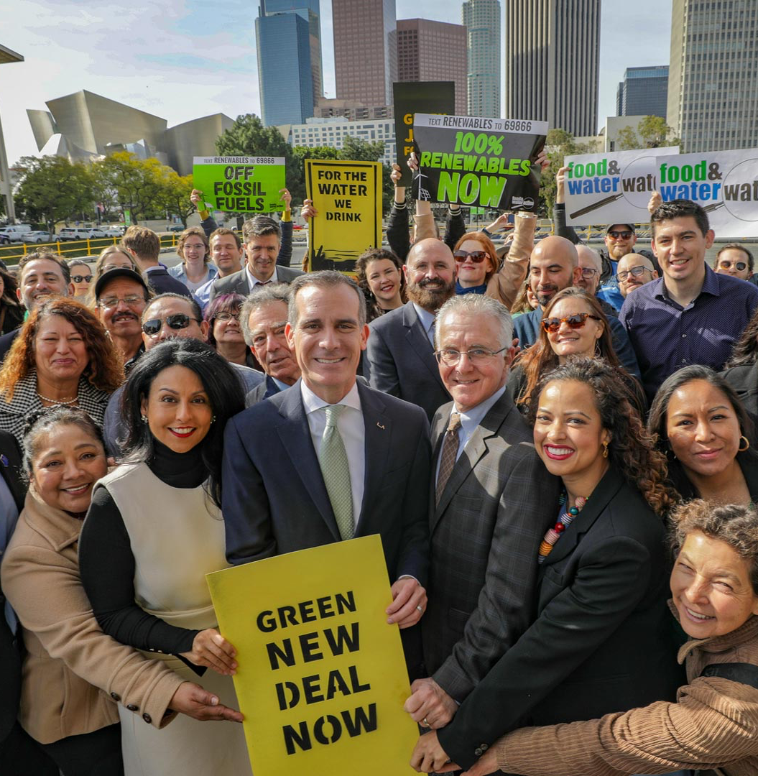
LA’s Green New Deal
Leading By Example
Policy Development
Public / Private Collaboration

Slide 3
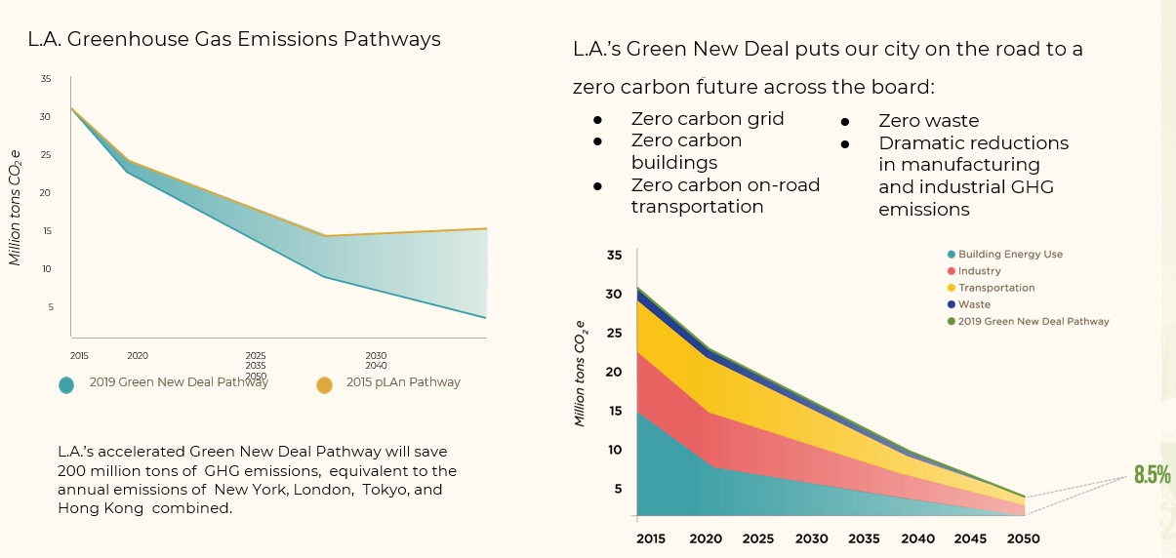
OUR CLIMATE EMERGENCY
Notes:
-Data clearly highlights the need to address transportation emissions.
-The 2019 GND process updated our 2015 Sustainability pLAn with new goals that are reflective of even more ambition, advances in technology, and ensuring a “Paris Compliant” strategy with respect to reducing our portion of carbon emissions.

Slide 4
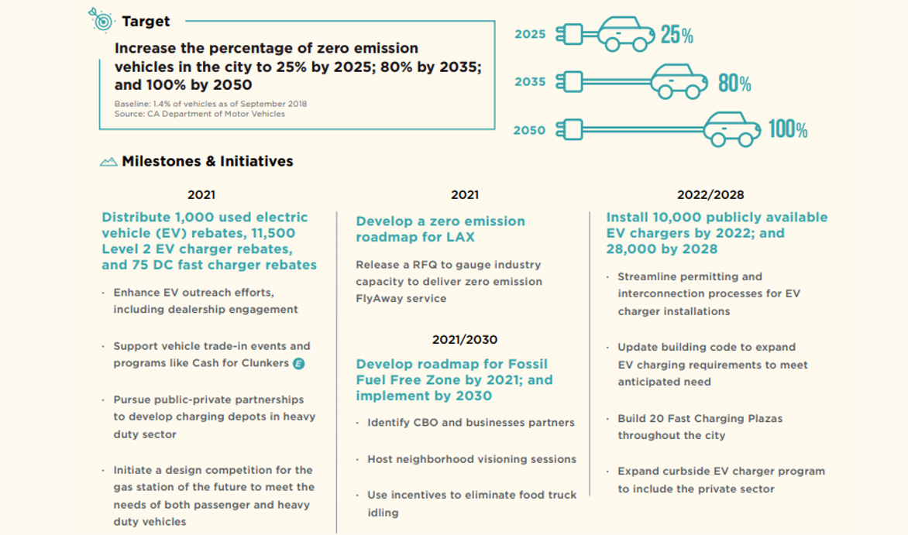

Slide 6
Lead By Example
Direct Municipal actions
-City Fleets
-ZE Public Transportation
-Fleet and Employee Chargers
-Curbside and public chargers
-LADWP - rebates and incentives
-EV Task Force
-Climate Mayors EV Purchasing Collaborative
Notes:
So what is our approach?
3 pronged approach to getting to 100% ZEVs, starting with leading by example.

Slide 7
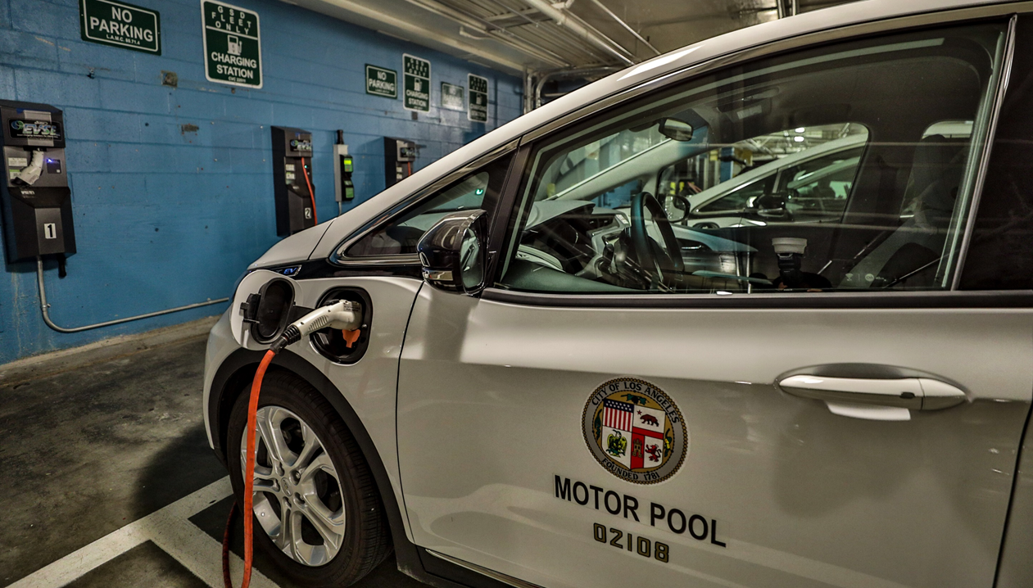
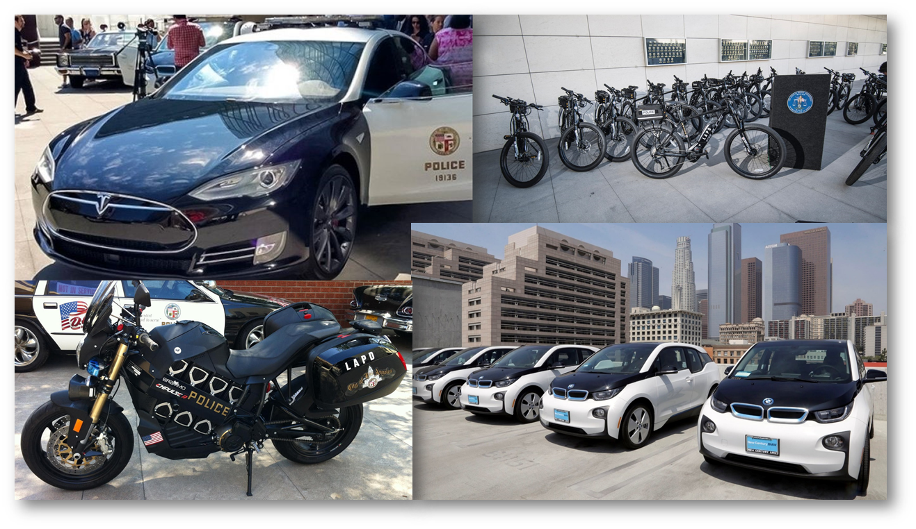
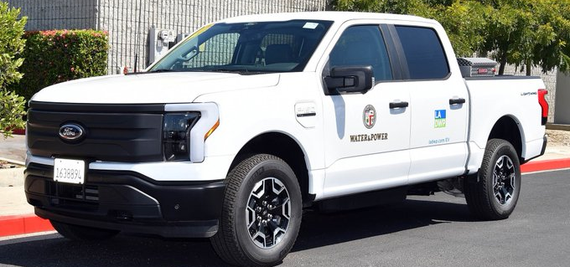
Municipal Fleets
1,500 BEVs & PHEVs
Zero Emission First Procurement Policy
Pilots
RCVs
Fire Engine
Class 8 Semi
MD flatbed / box truck
Riding lawn mower
Street sweeper
B&W Police Vehicle
Motorcycles
Scooters
Notes:
Police took the lead - no one else after that could say no
200+ LAPD Fleet (includes motorcycles and e-bikes)
20 LAFD
Parking Enforcement
Motor Pool
Assigned vehicles
Elected officials
LAWA- on field buses

Slide 8
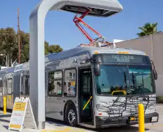
Zero Emission Public Transportation
LADOT - City Department
Fully Conversion by 2028
DASH - 35 BEB currently in fleet; 120 more on order (deliveries coming now)
Commuter Express - Coach bus
Cityride - pilot shuttle on order
LA Metro - LA sits on regional Board
Fully Converted by 2030
Initial deployments: Orange Line Silver Line Warner Center
Long term facility planning
Notes:
Also Metro bike and e-bikes

Slide 9
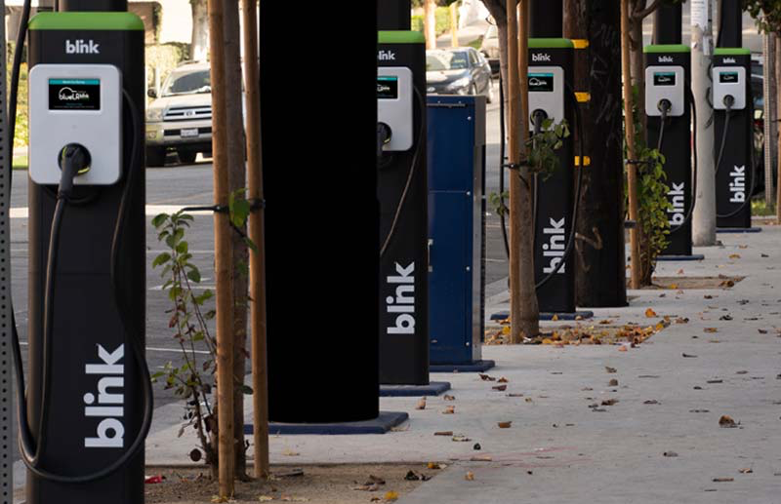
Zero Emission (Quasi) Public Transportation
BlueLA - Low Income EV Carshare
40 Stations; 200 Chargers
100 vehicles
Phase 2 - 60 stations, 200 vehicles
Notes:
Low Income EV Carshare
Phase 2 (awarded) - $3M
Step Grant (awarded) - Total $7M

Slide 10
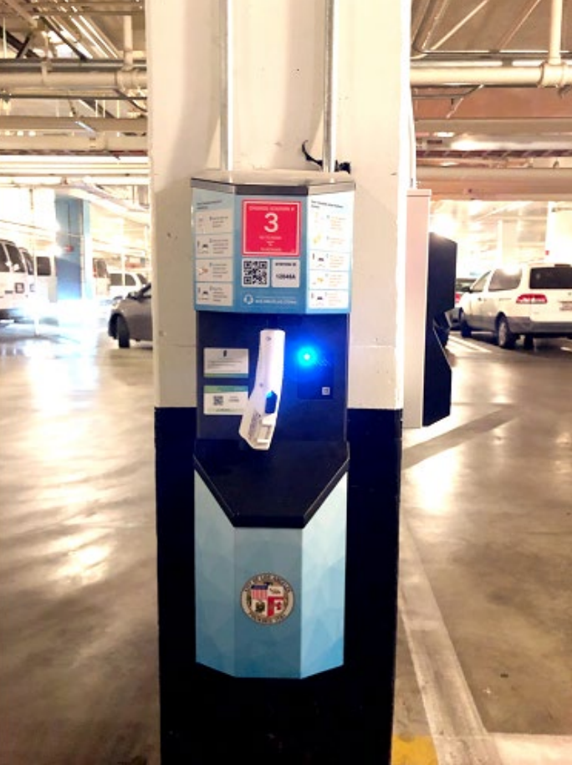
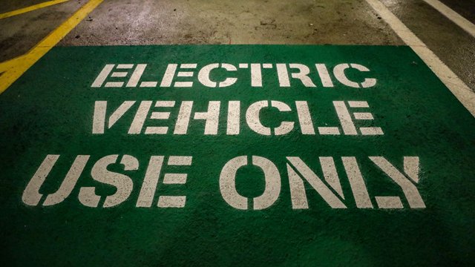
Employee & Fleet Charging
Notes:
Can take 18 mo. to 2+ years to get a charger in; vehicles can be ordered just like any other
If you build it they will come. Questions come up around gift of public funds; to make charging free or not for employees, when do you start, etc.

Slide 11
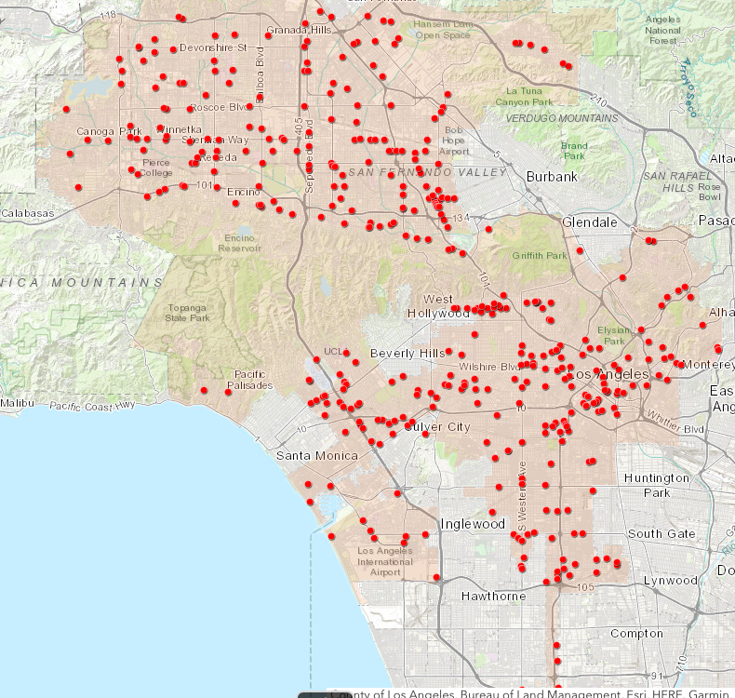
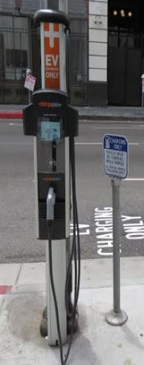
Curbside Charging
Notes:
In addition to these curbside chargers, CEC grant - nearly 200 more, including also DOT parking lots - including DCFC + 12 more on the way, Library Parking lots plus more on the way, 3 LAPD lots + LAWA

Slide 12
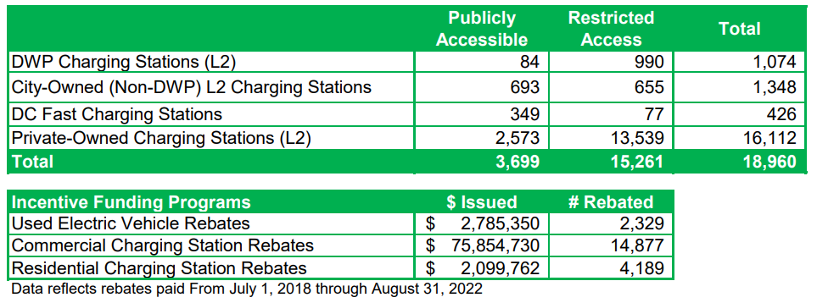
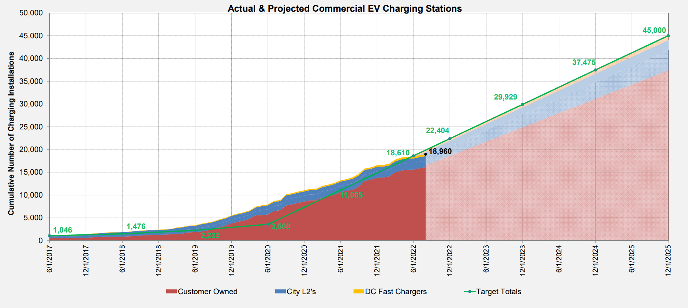
LADWP Rebates
& Incentives
-Residential
-Commercial L2
-DCFC
-MD/HD
-Used EVs
Next: Charging at specified times, V2G
Notes:
Leading by example also has to do with what we choose to spend money on. Having a municipal utility is very helpful...

Slide 13
Policy Development
Building Code
Enabling Curbside Charging
Enforceable EV Parking Spaces
Zero Emission Commercial Loading Curb
Port of Los Angeles Clean Air Action Plan
Working with CARB, CEC, CPUC, State and Federal Legislation
Establishing rules &
setting thresholds

Slide 14
Stakeholder Engagement
& P3 Efforts
Los Angeles ZE Bus Working Group
TNC Electrification Working Group
MD/HD ZE Freight Working Group
Gas Stations / Pump to Plug
NDEW and other marketing efforts
Zero Emission Area
Using the bully pulpit and convening power

Slide 15
Working Groups
ZE TNC Working Group
Uber / Lyft
Electrify America / EVgo / Greenlots
General Motors
DWP / SCE
CARB
Forth
Santa Monica / West Hollywood
LAWA / Taxi Franchise Administrator
Regional ZE Bus Working Group
LADOT
Foothill
Metro
AVTA
Burbank
Glendale
Santa Monica
Montebello
Gardena
UCLA
Torrance
Culver City
Long Beach
Beach Cities
MD/HD ZE Freight
Ikea / Amazon / UPS / FedEx
Coke / Pepsi / Anheuser Busch
TTSI / NFI / Dependable
CARB / CEC / SCAQMD

Slide 16
State and Federal Collaboration
(sometimes…)
State relationships matter:
GO Biz
CARB
CEC
LA area state legislators
Federal relationships more complicated
Hot and cold depending on administration
e.g. CAFE standards
California always the “example” - whether highlighting good or bad policies / outcomes
Notes:
Successes and challenges in these relationships
Basically like supersized versions of our local issues. Sometimes there’s lots of alignment. Sometimes very little.

Slide 17
Let’s Electrify!
michael.samulon@lacity.org

